Slide 1



Slide 2
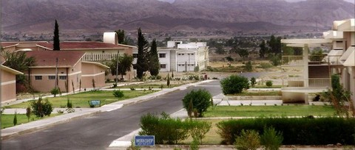


The Biomedical Engineering Program Balochistan University of Engineering and Technology Khuzdar Zero Visit Pakistan Engineering Council (PEC)

Slide 3
Vision and Mission of the Institute
Our Vision
To become a world class higher education institute leading to socio economic development of the region and beyond.
Our Mission
To impart quality education and research with professional excellence on strong ethical foundation to serve the region and beyond.
http://www.buetk.edu.pk/

Slide 4
Organogram of Balochistan University of Engineering and Technology Khuzdar
Vice Chancellor
Personal Staff
Pro Vice Chancellor
Dean Faculty of Engineering
Registrar
Protocol Officer
Controller of Examination
Director Postgraduate
Director General ORIC
Treasurer

Slide 5

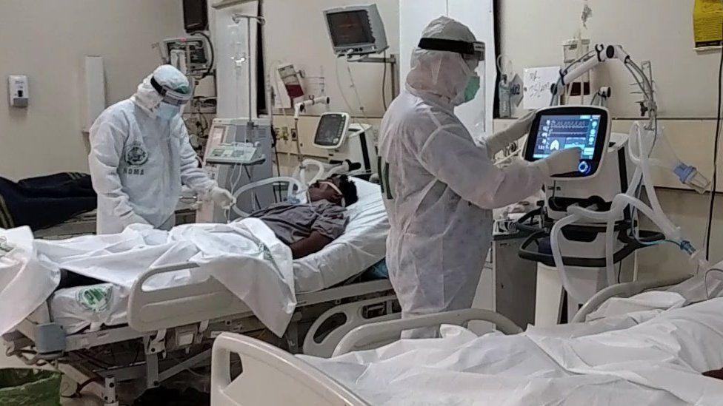

MOU with Jhalawan Medical College Khuzdar
Anatomy Lab
Biochemistry Lab
Physiology I Lab
Physiology II Lab

Slide 6

Vision and Mission of Biomedical Engineering Program
Our Vision
To become a leading Biomedical Engineering department in the region and beyond through advancement in biomedical technologies and research for human well being.
Our Mission
The graduates of Biomedical Engineering will be equipped with diverse range of skills to create enabling technologies and new knowledge for the improvement of human health.
The people of Balochistan facing limited health care facilities due lack of quality healthcare infrastructure, trained biomedical engineers and awareness regarding modern biomedical tools and equipments. The medical equipments in hospitals facing maintenance, upgradation and operational issues round the year.
The Biomedical Engineering Program will substantially increase health development, training and retention of the health workforce in Balochistan to achieve quality health coverage for all.
https://www.sdgpakistan.pk/web/sdgs

Slide 7
PEO Mapping with Mission
PEO Statement | Mission of Biomedical Engineering Program
PEO-1: Able to apply knowledge base with core foundation in Engineering, Biology, and Information Technology to solve complex biomedical engineering problems to facilitate the healthcare industry. | The graduates of Biomedical Engineering will be equipped with diverse range of skills to create enabling technologies and new knowledge for the improvement of human health.
PEO-2: Able to design, model, analyze and interpret the data and measurements and use engineering judgments to draw an effective conclusion.
PEO-3: Ability to work individually or as team members to provide leadership, international collaborations, promote ethical values and communicate effectively with a diverse range of audience.
PEO-4: Able to initiate self-directed learning for gaining knowledge to contribute to career development, innovation, societal development and entrepreneurship to serve the healthcare industry in the best manner.

Slide 8
PEO Mapping with PLO
 | PEO-1 | PEO-2 | PEO-3 | PEO-4
PLO-1 | ü |  |  | ü
PLO-2 | ü | ü |  | ü
PLO-3 |  | ü
PLO-4 |  | ü
PLO-5 | ü | ü
PLO-6 | ü |  | ü
PLO-7 | ü |  | ü | ü
PLO-8 |  |  | ü
PLO-9 |  |  | ü | ü
PLO-10 |  |  | ü
PLO-11 |  |  | ü
PLO-12 |  |  |  | ü

Slide 9
Organogram of Biomedical Engineering Program
Chairman
Department of Biomedical Engineering
Lab Staff
Teaching Staff
Non-Teaching Staff
Assistant Professor
Lecturer
Lab Engineer
Lab Assistant
Lab Attendant
Dean
Faculty of Engineering

Slide 10
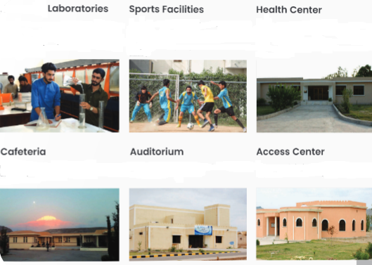
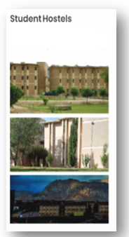
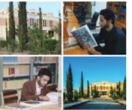
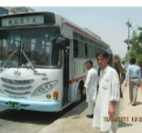
Available Facilities for Biomedical Engineering Program
http://www.buetk.edu.pk/

Slide 11
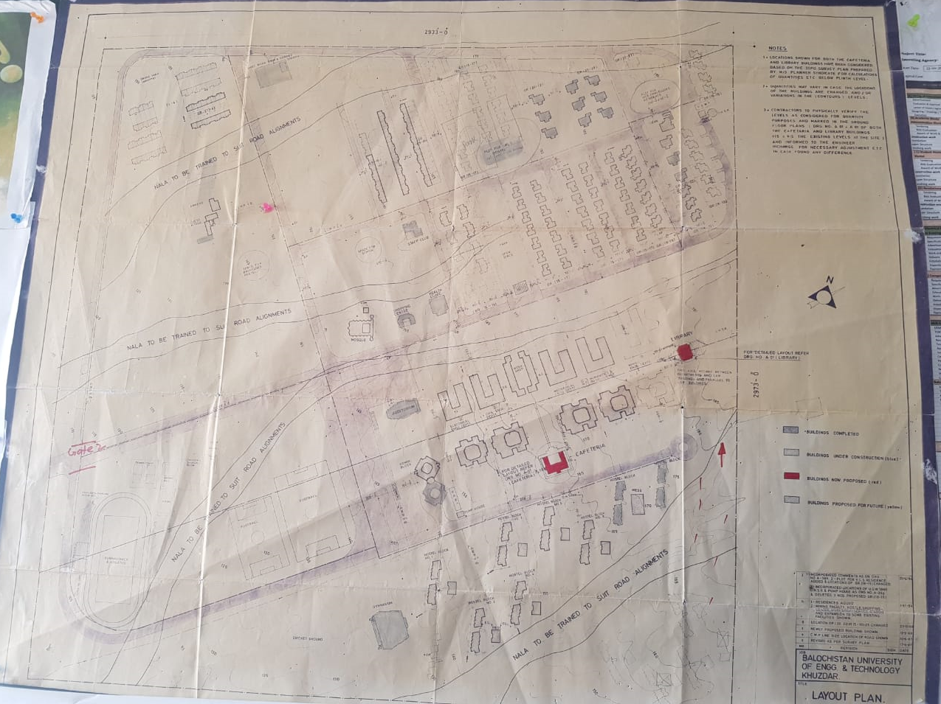
Plan to Build Dedicated Campus on Owned Land

Slide 12
Financial Resources
 | Endowment fund, regular fund-generation and other available resources. Budget allocation (if applicable): For last three years for University/ Institution (if applicable Current Budget of proposed program (If Zero Visit) | PKR. 20.000 Million PKR. 304.079 Million

Slide 13
Break up of the Current Budget for the Program (2021-2022)
S.No. | Budget Head | Annual Allocation (Rs)
1 | Operational Budget
 | 1.1 | 6.916 million
 | 1.2 | 1.000 million
Total |  | 7.916 million

Slide 14
Break up of Budget for the next year (2022-2023)
S.No. | Budget Head | Annual Allocation (Rs)
1 | Operational Budget
 | 1.1 | 7.216 million
 | 1.2 | 1.000 million
Total |  | 8.216 million

Slide 15
Curriculum
Domain | Knowledge Area | Total Courses | Total Credits
Non-Engineering | Humanities | 5 | 12
 | Management Sciences | 2 | 6
 | Natural Sciences | 7 | 23
 | Sub-Total | 14 | 41
Engineering | Computing | 3 | 9
 | Engineering (Biomedical) Foundation (Core) | 9 | 25
 | Major Based Core (Breadth) | 6 | 23
 | Major Based Core (Depth) | 3 | 9
 | Interdisciplinary Eng. Breadth (Electives) | 7 | 25
 | Senior Design Project | 1 | 6
 | Industrial Training | 0 | 0
 | Sub-Total | 29 | 97
TOTAL |  | 43 | 138

Slide 16
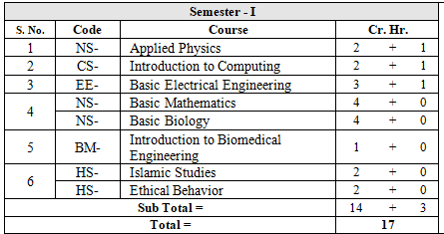
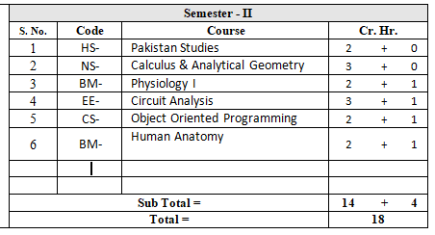
Course Plan of 1st and 2nd Semester

Slide 17
Student Induction
Criteria of Induction | As per BUETK admission policy (given in prospectus)
Induction Weighatge | Matric (10%) F.Sc (40%) Entry Test (50%)
Proposed strength and schedule of intake | One batch of 50 students per year
Proposed Distribution into number of section | Single section/class
http://www.buetk.edu.pk/

Slide 18
Teaching Faculty
Chairman
Dr. Wazir Muhammad (Biomedical Image Processing)
Assistant Prof: Dr. Muneeza Khan (Biomedical Engineering)
Lecturer.
Engr. Nazia Ejaz
(Biomedical Engineering)
Assistant Prof: Dr. Muhammad Ilyas
(Biomedical Control System)
Lecturer: Engr.
Muhammad Waqar (Biomedical Engineering)
Dr. Talal Jameel (Biomedical Engineering IPFP Fellow)

Slide 19
Faculty Publications and Funded Projects
Sr.No | Name Faculty Member | No of Publications
1. | Dr. Muhammad Wazir | 16
2. | Dr. Muhammad Ilyas | 10
3. | Dr. Muneeza Khan | 09
4. | Dr. Talal Jamil | 12
5. | Engr. Ms Nazia Ejaz | 02
6 | Engr. Muhammad Waqar | 06
Sr.no | Title of Funded Project | Funding Agency | PI | CO PI | Budget (PKR)
1 | Hydrogel based triboelectric nanogenerators for self-powered point-of-care devices. | HEC NRPU | Dr. Muneeza Khan (BUET Khuzdar) |  | 4.7 million (Awarded)
2 | CoVid-19 Vaccine Smart Preserving (VSP) Module | HEC NRPU | Dr. Yousaf Khan (UET Peshawar) | Dr. Muhammad Ilyas (BUET Khuzdar) | 12.66 million (Pending for approval)

Slide 20
Shared Faculty
Sr.no | Name | Designation | Subject
1 | Mr. Shae Mazar | Lecturer | Basic Mathmatics
2 | Mr. Mehboob Shah | Lecturer | Calculus & Analytical Geometry
3 | Mr. Mumtaz Ali | Lecturer | Complex Variable & Transformation
4 | Mr. Habib us Salam | Lecturer | Pakistan Studies
5 | Mr. Gul Muhammad | Lecturer | Islamic Studies
6 | Ms. Hajira Masroor | Assistant Professor | Technical Report Writing

Slide 21
Laboratories and Allied Facilities
S. No. | Labs | Location | Dedicated/Shared
1. | Biomechanics and Rehabilitation lab | Mechanical Engineering department | Dedicated(Under Development)
2. | Engineering Mechanics Lab | Mechanical Engineering department | Shared
3. | Computer Lab | Computer System Engineering | Shared
4. | Electronics Lab | Electrical Engineering Department | Shared
5. | Anatomy Lab | Jhalawan Medical College | Shared
6. | Biochemistry | Jhalawan Medical College | Shared
7. | Physiology I & II | Jhalawan Medical College | Shared

Slide 22
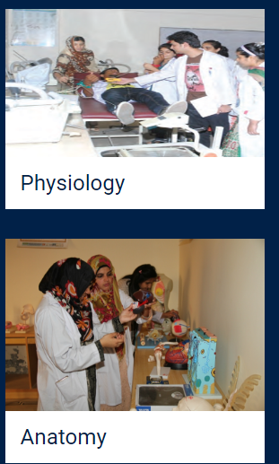
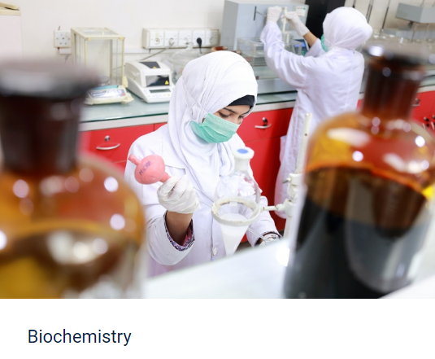
Laboratories and Allied Facilities
http://www.jmck.com.pk/

Slide 23
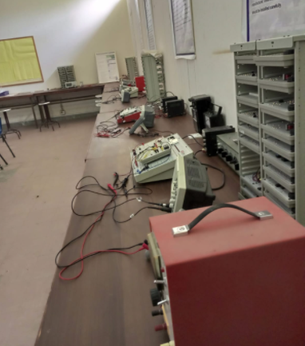
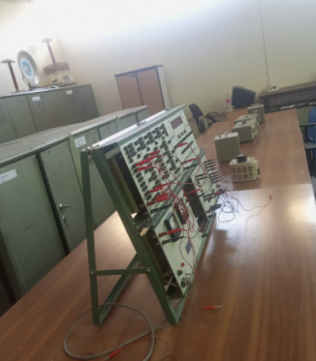
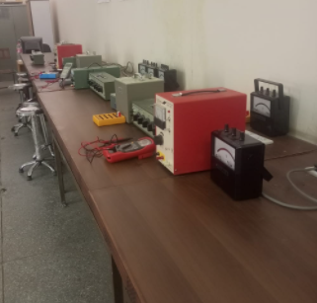
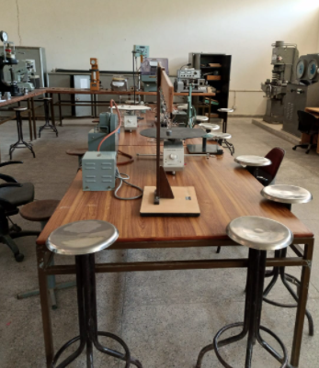
Laboratories and Allied Facilities
Basic Electronics Lab
Basic Electrical Engineering Lab
Basic Electrical Engineering Lab
Applied Physics Lab
https://www.buetk.edu.pk/electrical-engineering-department/

Slide 24
Classrooms and Lecture Halls
Number of Classrooms | 4
Number of lecture Halls | 2

Slide 25
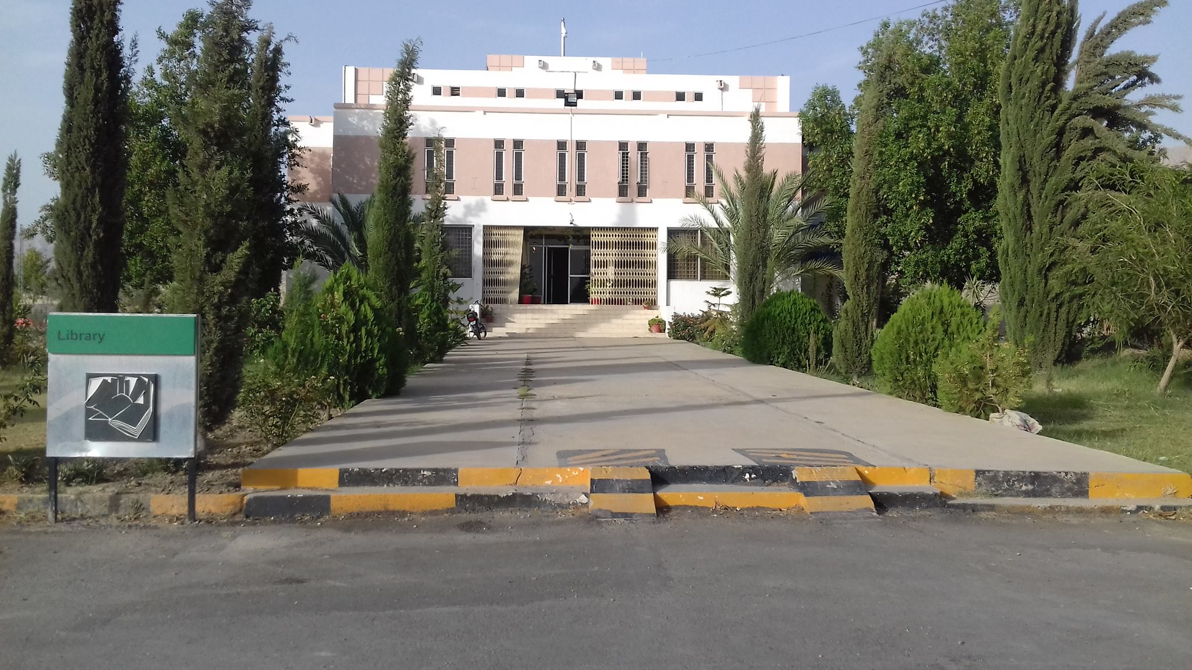
Library
The University fully furnished central Library established in 1987, having more than 35000 Technical Books, Research Journals, and Magazines national and local newspapers. The university Library has also access to many reputed online Journal through HEC digital Library.
We provide vital support for students, researchers and staff, complementing academic activities, and make available access to the world of information print or online, multimedia and Internet facility.
https://www.buetk.edu.pk/library/

Slide 26
Library
Number of Titles | Total No Books of Biomedical Engineering
34 | 1049
Number of Titles | Total No Books of other related disciplines(Electronic, Humanities)
50 | 1100
https://www.buetk.edu.pk/library/

Slide 27
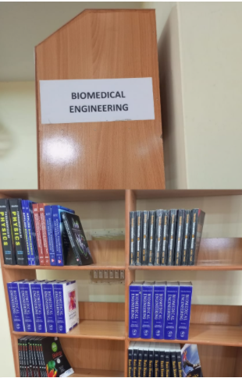
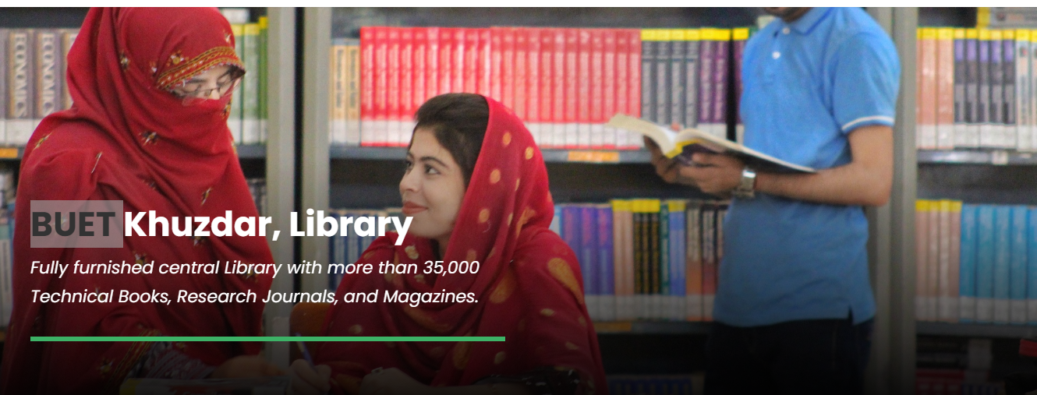
Library
https://www.buetk.edu.pk/library/

Slide 28

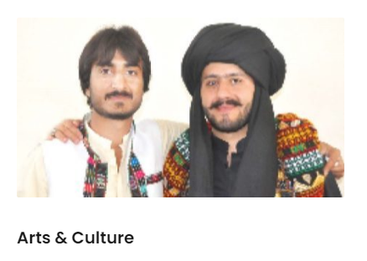
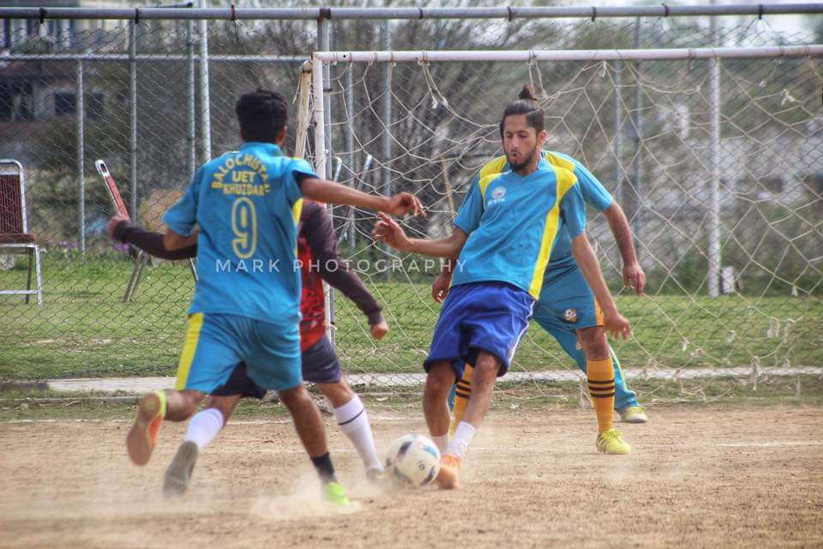
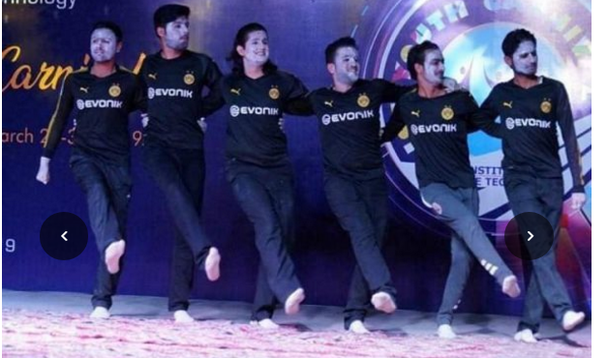
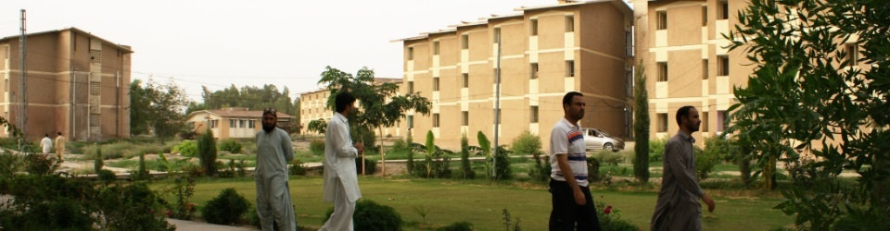
Sports and Other Facilities
https://www.buetk.edu.pk/university-life/

Slide 29
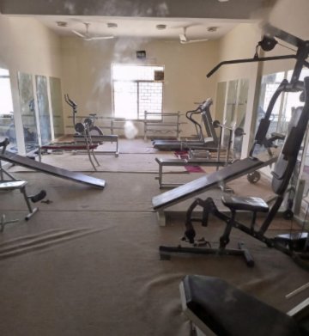
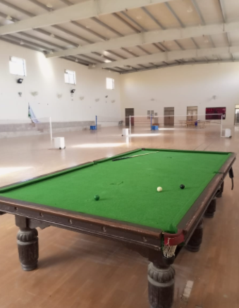
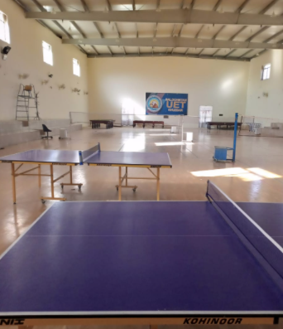
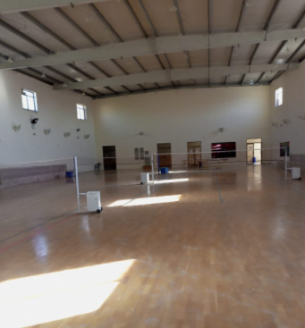
Indoor Games
Gym
Snooker Club
Table Tennis
Badminton Court
https://www.buetk.edu.pk/university-life/

Slide 30
Thanks

